Slide 1
West Dunbartonshire
Employability Grant Programme
Information Session
Stephen Brooks – West Dunbartonshire Strategic Employability Group Chair/Working4U Manager West Dunbartonshire Council

Slide 2
Introduction and Background to the Grants Programme
Add value to the funding and other resources already available and create opportunities for innovation and collaboration.
Provide a new commissioning process for the allocation of funds.
Support the aims and objectives outlined in the:
West Dunbartonshire Strategic Plan 2017- 2022: West Dunbartonshire Strategic Plan 2017 – 2022
Economic Development Strategy: West Dunbartonshire Economic Development Strategy
Community Planning West Dunbartonshire Local Outcome Improvement Plan 2017 -27: Community Planning West Dunbartonshire Local Outcome Improvement Plan 2017-27
No One Left Behind: No One Left Behind: delivery plan - gov.scot (www.gov.scot)
West Dunbartonshire Challenges and Themes: West Dunbartonshire Challenges and Themes
April 23– End March 2024.
£300k minimum –Not invested in any single organisation. No organisation will receive more than 33% of funding except in exceptional circumstances
https://www.west-dunbarton.gov.uk/business/grant-and-loan/working4u-employability-grants-programme/

Slide 3
Our Grant Outcomes and Principles
Both Scottish and Local Government are committed to the shared ambition of No One Left Behind, to deliver a Scottish approach to employability that focuses on the needs of the individual first and foremost. A person-centred approach that is more flexible and responsive to the changing labour market, tackles inequalities and grows Scotland’s economy is needed now more than ever to shape a collective economic and wellbeing response.
Key Outcomes
Inactive and unemployed residents entering employment
Sustained employment for residents who have entered employment
Improved labour market situation for those in employment
Increasing income through employment for low-income families

Slide 4
Our Grant Outcomes and Principles
6 NOLB Principles
flexible and person-centred support
Be more straightforward for people to navigate
Be better integrated and aligned with other services, particularly with health, justice and housing provision
Provide pathways into sustainable and fair work
Be driven by evidence, including data and the experience of users
Support more people – particularly those facing multiple barriers – to move into the right job, at the right time

Slide 5
Our Grant Outcomes and Principles
8 West Dunbartonshire Principles:
Services should be configured around the needs of the clients
‘Travel to work’ should be considered
Applicants should be prepared to become an active partner in the West Dunbartonshire Partnership
Applicants should also be prepared to make use of the Working4U pages within the West Dunbartonshire Council website
Ensure lived experience shapes service design and delivery as outlined in the Scottish approach to service design
Ensure that the design of services have considered the needs of those with protected characteristics
Provide additionality to existing provision available in West Dunbartonshire with connectivity, where permissible, to established provision and building progression
Provision must not put at risk participants current eligibility for benefits or lead to a reduction in overall income
Notes:
Services should be configured around the needs of the clients rather than delivery partners
‘Travel to work’ should be considered with participants to help overcome barriers (both physical and perceived) and support access to opportunities out-with their local area and across West Dunbartonshire and the wider Glasgow City Region
Applicants should be prepared to become an active partner, making use of the SEG resources such as training and development activity, events and be prepared to participate as appropriate in the West Dunbartonshire: Creative Design Group; Frontline Workers Forum; and Data Toolkit. In particular, applicants should be prepared to utilise a new Continuous Improvement Toolkit for employability services currently in development by the Scottish Government, links to which will be provided to successful applicants
Applicants should also be prepared to make use of the Working4U pages within the West Dunbartonshire Council website and associated social media platforms to advertise activities and promote regular good news stories. This will include posting all provision funded through the grants programme on our Strategic Skills Pipeline portal. More information and training on this will be made available with grant award documentation
Ensure lived experience shapes service design and delivery as outlined in the Scottish approach to service design
Ensure that the design of services have considered the needs of those with protected characteristics
Provide additionality to existing provision available in West Dunbartonshire with connectivity, where permissible, to established provision and building progression routes into Further/Higher Education, Modern and Graduate Apprenticeships and other appropriate provision, as well as supporting access to employment
Provision must not put at risk participants current eligibility for benefits or lead to a reduction in overall income

Slide 6
What Type of Provision Are We Looking For?
Stage 1 | Stage 2 | Stage 3 | Stage 4 | Stage 5
Engagement | Assessment/Registration and Barrier Removal | Vocational Activity | Employer Engagement and Job Matching | In work support and aftercare
Engagement through targeted outreach in communities Active engagement with key intermediaries and agencies Engagement through Social Media | Assessment of needs Developing and providing back to work Action Plans Registration on programme Personal development Basic Life Skills Specialist Support e.g., debt/financial, homelessness, substance misuse etc. Community Learning English for Speakers of other Language (ESOL) IT for Beginners Identifying pre-employment training requirements | Employability Skills Training Job Searching Strategies Core Skills Mentoring Career Guidance Sector Specific Skills Training IT Training Access to IT services for Applications and Job Searching Work Placements Enterprise Awareness Voluntary Work | Employer Engagement & Support Addressing Employer misconceptions of target groups Innovative approaches in partnership with West Dunbartonshire and City Region businesses Effective promotion of existing incentives Job Matching | Support to help Employee retention Client tracking to ensure sustained employment Intermediate labour market initiatives Initiatives to tackle in work poverty Up-skilling the work force Childcare support

Slide 7
Priority Groups
Armed Forces Veteran
Asylum Seeker
At Risk of Becoming NEET (Not in employment, education or training)
Care Experienced
Criminal Convictions
From Employment Deprived Areas
Homeless or Affected by Housing Exclusion
Living in a Jobless Household
Living in a Jobless Household with Dependent Children
Living in a Single Adult Household with Dependent Children
Long Term Physical Illness
Low Income Employed
Low Skilled
Mental Health Issues (young people and adult)
Migrants people with a foreign background, minorities (including marginalised communities such as the Roma)
Unemployed
Economically inactive
No or Limited Work Experience
Primary Carer of a child/children (under 18) or adult
Primary Carer of older person
Refugee
Substance related conditions
Underemployed
Disabled and/or deaf person (includes those experiencing mental health issues and those who have an impairment or long-term health condition)
Person aged over 50 years
Living in a household with children in poverty
Lone Parents
Families from Minority Ethnic Communities
Families with a Disabled Child
Disabled Parent
Families with 3 or more Children
Families where the Youngest Child is under 1
Young parents under the Age of 25

Slide 8
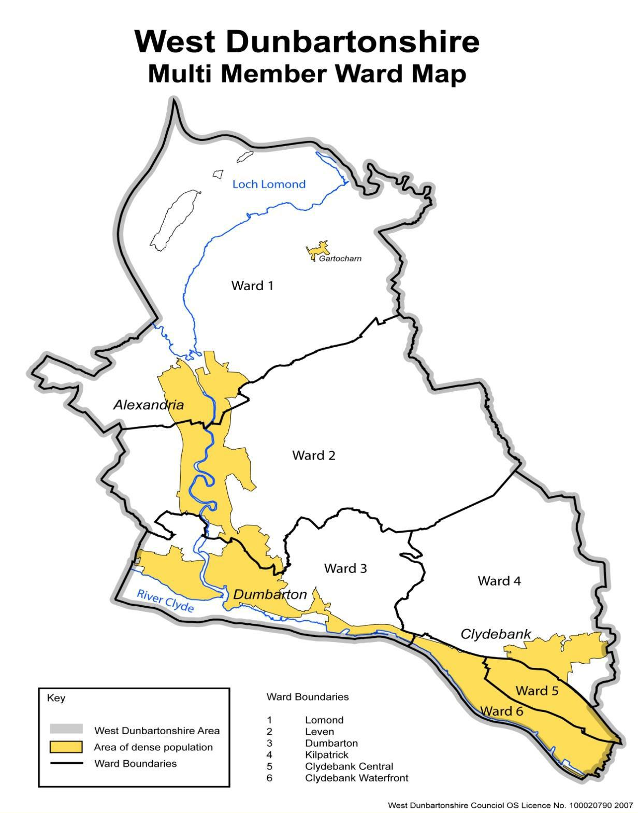
Priority Areas

Slide 9
Provision Should Be …
appropriate for the age and stage of the target participant group,
proportionate to the numbers of unemployed,
where possible/appropriate delivered locally in facilities that are accessible to all.
needed locally and not duplicate existing provision,
in line with current and future labour markets, skills requirements, and job vacancies

Slide 10
The Application Process
Key milestones
Who can apply?
What is eligible spend?
What makes a good application?
Who decides?
How?

Slide 11
Grant Payment Process T&Cs
How will we pay the grant?
What is it dependant on?
How do we monitor and evaluate performance?
How will we report?

Slide 12
The Application Form https://view.officeapps.live.com/op/view.aspx?src=https%3A%2F%2Fwww.west-dunbarton.gov.uk%2Fmedia%2F332bkfwl%2F_1b-west-dunbartonshire-employability-grants-programme-application-form-stage-3-sept-23-final.docx&wdOrigin=BROWSELINK

Slide 13
How We Will Help
Data and information.
Employability Grant Guidance
Contact point for further information requests or queries
You should be able to find the answers to most of the questions you may have about this Grant Award Programme within the published documentation. If, however, after checking through the published documentation, you need to ask a question then please email your query to: https://www.west-dunbarton.gov.uk/business/grant-and-loan/working4u-employability-grants-programme/
Please note that the deadline for submitting questions is midnight on 22nd of September 2023 and that responses to questions submitted after this deadline cannot be provided.
Use of new pages on the West Dunbartonshire Council Website
https://www.west-dunbarton.gov.uk/nolb

Slide 14
Timetable:
Grant opens for applications: Monday 11th September 2023
Eventbrite-Information Session Friday 15th September 2023, 11am – 12.30pm.
Application deadline: Noon, Friday 29th September 2023
Assessment panel: w/c 2nd October 2023
Application outcomes notified: w/c 9th October 2023
Award letter issued: w/c 9th October 2023
Delivery Starts: From October 2023
Delivery end: 31 March 2024 dependent on contract awarded

Slide 15
Q&As

