Slide 1



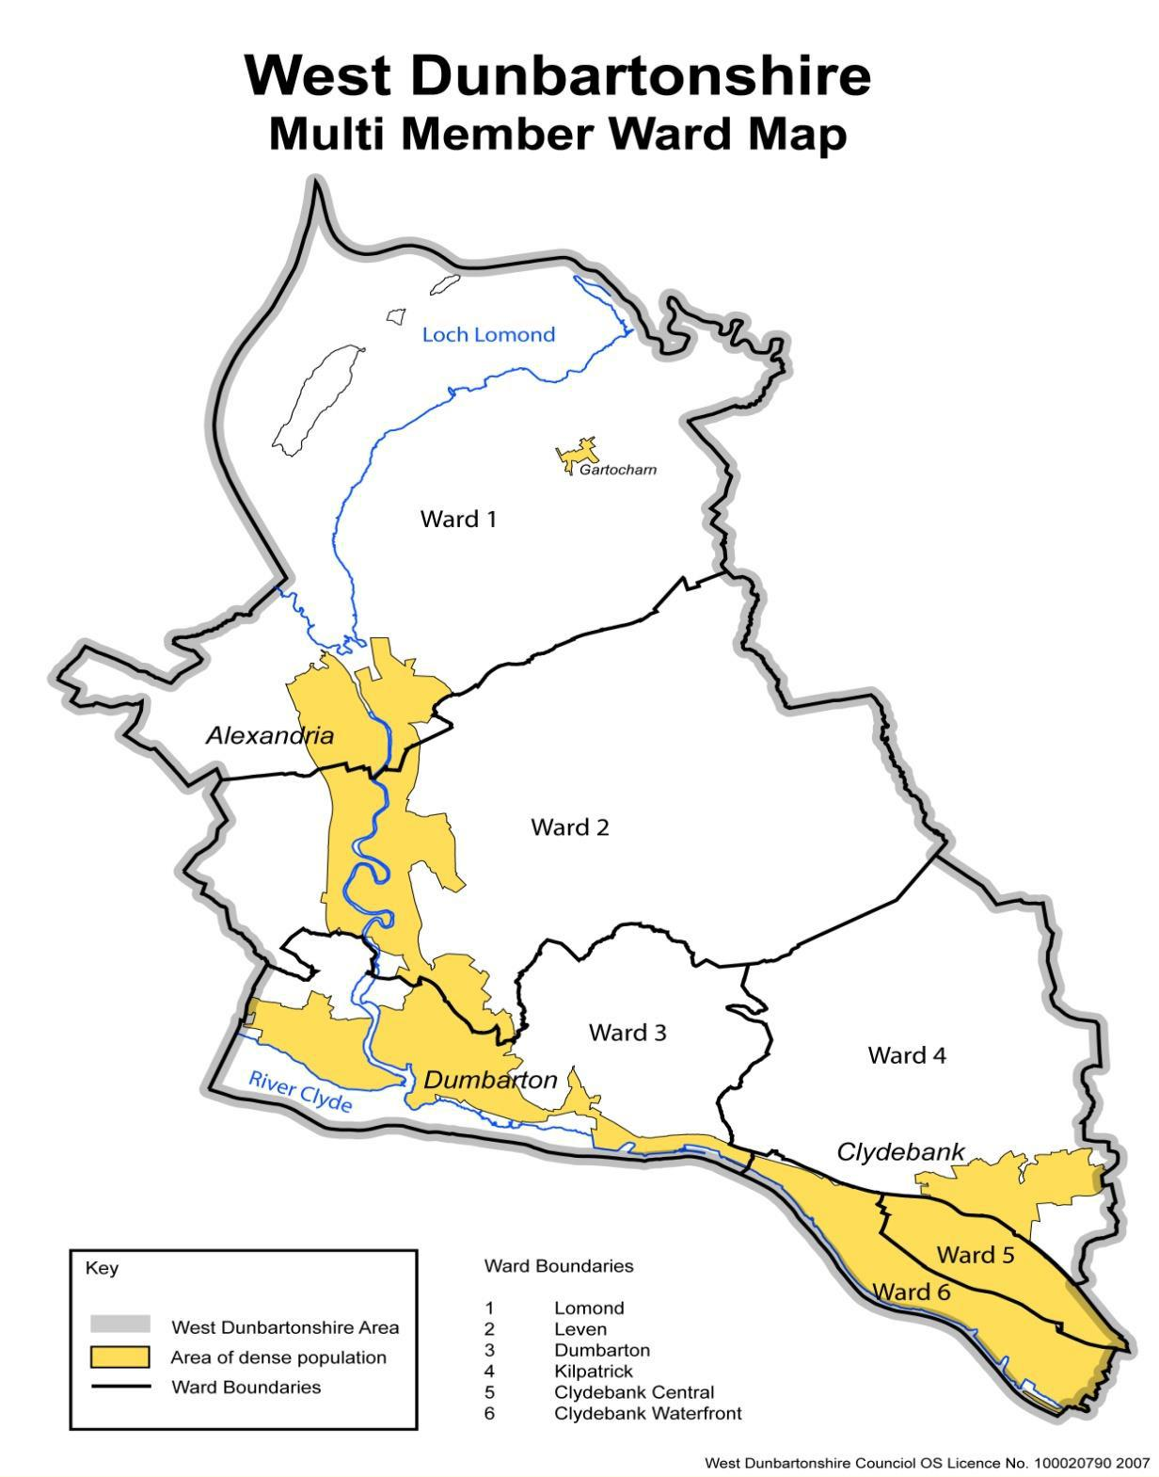
Priority Groups
West Dunbartonshire Employability Grants- Information Session 26-27
Clare Henry – Working 4U Coordinator

Slide 2
Funding Available
At present approx. £300,000 is available for commissioning.
Funds that will contribute to delivery in 26/27 are as follows:
UK Government Shared Prosperity/Local Growth Fund
Scottish Government -No One Left Behind (NOLB)
Scottish Government - Parental Employment Support
Scottish Government - Specialist Employability Support
NOLB Strategic Plan No One Left Behind: employability strategic plan 2024 to 2027 - gov.scot
Local Growth Fund Scotland - Local Growth Fund (Scotland) Prospectus - GOV.UK

Slide 3
Our Grant Outcomes and Principles
Key Outcomes
Reduce inequality in the labour market by providing employability services to those who are unemployed and furthest removed from the labour market, including those who are economically inactive
Reduce levels of child poverty by supporting parents to increase their income from employment. This must include support for out-of-work parents as well as support for parents who are in low-income employment. Priority family groups are:
  Lone parent families
  Minority ethnic families
  Families with a disabled person
  Families with three or more children
  Families with children under the age of 1
  Families with mothers aged 25 or under

Slide 4
Our Grant Outcomes and Principles
Contribute to a reduction in the Disability Employment Gap by providing support to disabled people to enter and retain employment.
Ensure a mixed economy of employability provision in all Local Authority areas
Work in partnership with wider public services to ensure streamlined referral mechanisms and wrap-around support is available to people accessing employability services
Work with employers locally to support successful and sustained outcomes for participants, including but not limited to, delivering training opportunities to participants aligned to local labour market demands
Support participants to enter green jobs as part of wider priorities to support a Just Transition

Slide 5
Our Grant Outcomes and Principles
Provision should be delivered in line with resources available in the National Products Handbook including;
  •Shared Measurement Framework
  •Service Standards
  •Customer Charter
  •Local Employability Partnership Framework
  •Good Practice Guidance on Commissioning Employability Services in Scotland

Slide 6
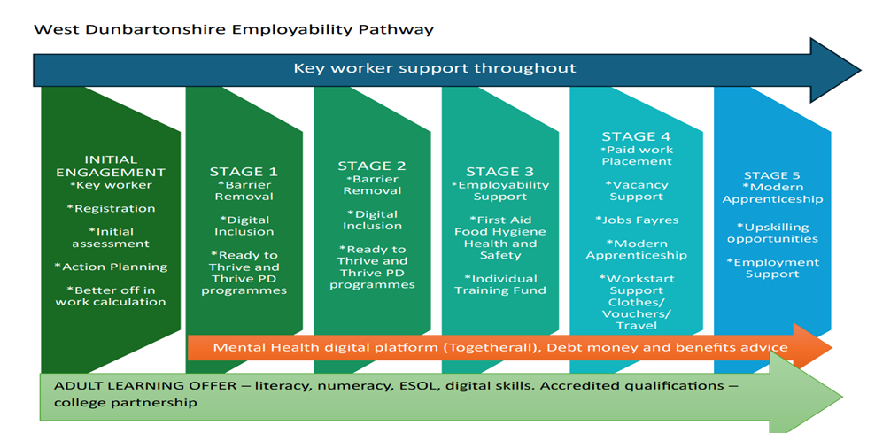
Working 4U Employability services

Slide 7
What Type of Provision Are We Looking For?
Priority Group(s) and Themes | Rationale/evidence of need /useful data | Pipeline Stages | Fundable Provision
Families facing poverty - Parents/kinship carers including those affected by in-work poverty. | 25.6% of children in West Dunbartonshire are living in poverty. A key focus of our parental employment work is to reach those parents more likely to be impacted by poverty: Single parents Families impacted by disability Parents under 25 Parents with children under 1 Parents with 3 or more children Ethnic minority parents Experience of the care system W4U have a key worker presence in all local high schools, provision commissioned will enhance the key worker model. | Stages 1-5 | 1.1 Programmes supporting parents into employment 1.2 Programmes supporting employed Parents to upskill and increase income through work.

Slide 8
What Type of Provision Are We Looking For?
Priority Group(s) and Themes | Rationale/evidence of need /useful data | Pipeline Stages | Fundable Provision
Vocational Activity - residents requiring vocational skills and work experience to progress into employment | The LEP recognises the need to provide vocational skills training in sectors where there are likely to be vacancies over the coming year. The aspiration of the SEG is to support those gaining vocational skills to progress into related and sustainable work opportunities in West Dunbartonshire, or within other travel to work areas. We have an all age offer in Working4U with people requesting vocational training. (Working4U has the ability to offer vocational training in customer care and social care). Some of this can be met through accessing training on an individual basis however we require a wide range of relevant vocational courses for groups of clients to meet client and employer needs. This support should offer progressions for residents participating in wellbeing and personal development programmes. | Stages 3/4 | 2.1 Delivery of vocational skills programmes/sector-based work academies, which are linked to local employers and evidenced work opportunities. Programmes must include a minimum of 2 weeks work experience and guaranteed interviews. We need to ensure our provision meets the specific needs of our priority groups who may benefit from a more targeted and bespoke programme, in particular: Parents – who need training provision and jobs with school /parent friendly hours and conditions. People with disabilities and Long Term Health Conditions Vulnerable Young people who require vocational programmes adapted to meet their specific needs and job opportunities including apprenticeships.

Slide 9
What Type of Provision Are We Looking For?
Priority Group(s) and Themes | Rationale/evidence of need /useful data | Pipeline Stages | Fundable Provision
Community Justice – Justice System experienced residents | In Scotland, approximately 1 in 3 men and 1 in 10 women of working age have a criminal conviction. Engaging with the community justice experienced population is recognised as particularly challenging. Grant applicants are encouraged to clearly identify how they will do this. | Stages 1-5 | 3.1 Specialist support for people with experience of the Community Justice system which are impacting on access to employers/jobs. Working closely with Social Work colleagues to identify clients who will benefit from employability support across the justice process. Evidence suggests that access to specialist support and guidance to justice experienced residents and potential employers in relation to convictions and access to appropriate work experience placements will be a key aspect of delivery.

Slide 10
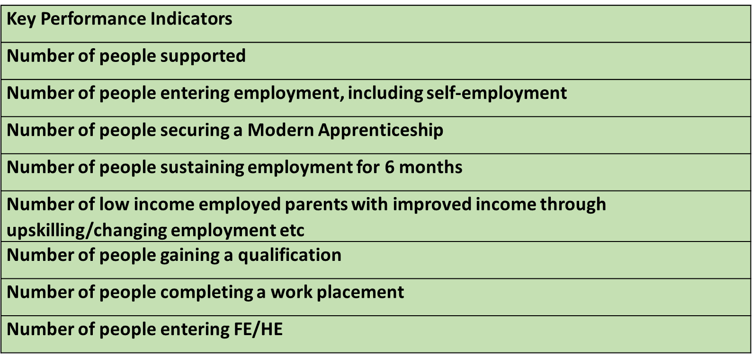
Key Performance Indicators

Slide 11
Milestones
Milestone | Date
Grant opens for applications | 02/04/2026
Information sessions for potential applicants | 16/04/2026 at 1.00pm
Individual discussions to support applications online is optional | 20th April - 24th April
Q&A open | 02/04/2026
Q&A closure | 08/05/2026
Application deadline | 15/05/2026 noon
Assessment process | Week beginning 18th of May 26
Application outcomes notified | Week ending 22nd May 26
Delivery end | End March 2027

Slide 12
The Application Form

